Slide 1
Microsoft Bot Framework

Slide 2
Overview
Introduce Core Concepts
Build a simple bot
Introduce LUIS
Build a “smarter” bot

Slide 3
Bot Framework
Bot Framework is a platform for building, connecting, testing, and deploying powerful and intelligent bots
.NET, Node.js, and REST
Provided as a SDK

Slide 4
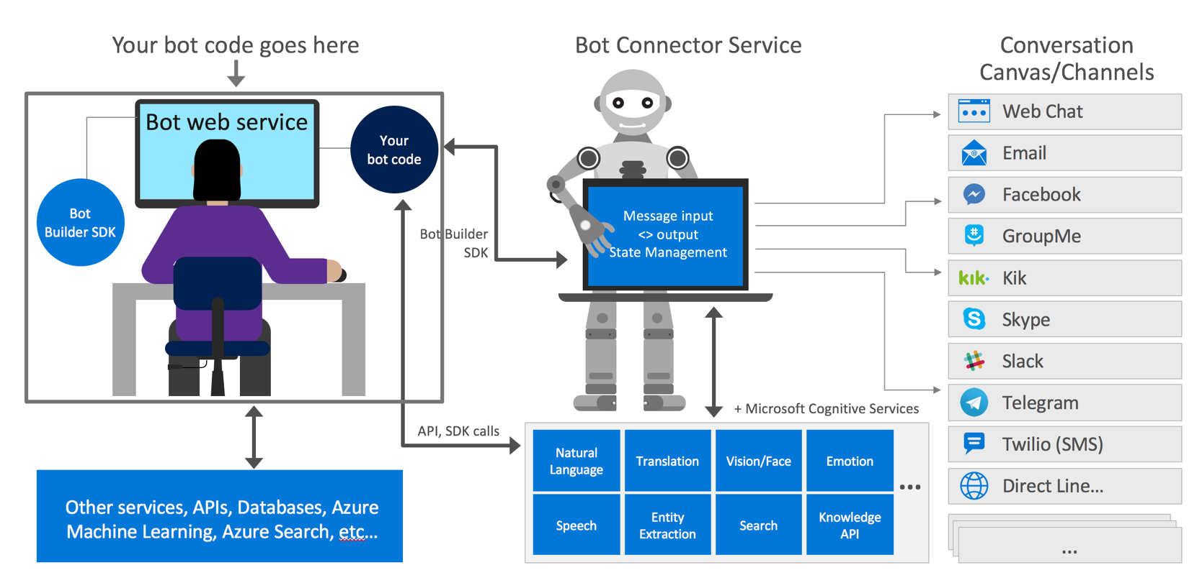

Slide 5
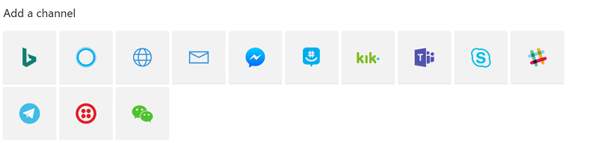
Core Concepts - Channels
Connection between bot framework and communication apps
Slack
Kik
Facebook Messenger
Skype
etc.

Slide 6
Core Concepts - Dialogs
Used to model a flow of a conversation
Reusable
Persisted state
Types:
Prompts
Natural Language Understanding
Form Filling
Profile

Slide 7
Core Concepts - Context
Gives access to conversation state
Send data to a user
Wait for input from the user
Push a new dialog on to the stack
Pop current dialog from the stack
Notes:
Wait for input from user – pushing a continuation onto the stack to be executed.

Slide 8
Programming Time!
Ask the user their name
Ask the user their email address
3. Welcome the user to your bot.
https://github.com/aidanmorgan/chatbot-workshop
RootDialog.cs

Slide 9
Core Concepts – Dialog Stack
Dialogs can be pushed onto and popped off the stack
Top dialog in the stack processes all incoming messages
Data can be pushed from one dialog to it’s child
Data can be returned from a child dialog to it’s parent

Slide 17
EXAMPLE

Slide 18
Message Types (Cards)
Can be rendered as a list or a carousel
Rich cards:
AnimationCard
AudioCard
HeroCard
ThumbnailCard
SignInCard
VideoCard
May contain buttons
Good for simplifying user input
Can contain input hints
Show/hide keyboard

Slide 19
Advanced Features
Integration with multiple channels
Send “proactive messages”
Building complex forms from simple DTO’s
Dialog Chains

Slide 21
Natural Language Processing
Combination of Computer Science, Machine Learning and Computational Linguistics
Concerned with:
Understanding Language
Synthesising Language
Ideally want to discover the user’s “intent”

Slide 22
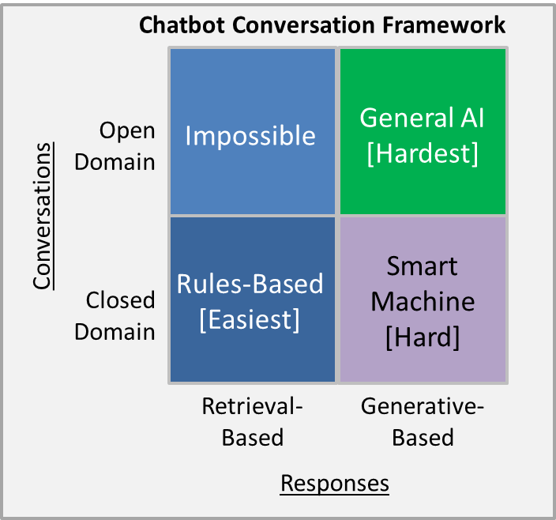

Slide 23
Understanding Language - Challenges
“Boy paralysed after tumour fights back to gain black belt”
“Scientists study whales from space”
“Juvenile Court to Try Shooting Defendant”

Slide 24
Microsoft QnA Maker
Build a Q&A bot based on FAQ’s
Structured documents
Manually entered pairs
Simple REST endpoint for integration
Fast to create/deploy and easy to retrain

Slide 25
DEMO TIME!
Notes:
Add “where conference”:
“Where is the conference this year?” – The Perth Convention and Exhibition Centre
“Where is the conference?” – The Perth Convention and Exhibition Centre
“Where?” - The Perth Convention and Exhibition Centre
Add “when” questions:
When – 16th September 2017

Slide 26
Microsoft LUIS
LUIS “Language Understanding Intelligent Service”
Discovering user’s “intent”
Named Entity Recognition
Provided as a Service
http://luis.ai
Notes:
Don’t go all NLP, it’s best as “glue” between “on rails” conversations.

Slide 27
DEMO TIME!
Notes:
Add a weather example – weather for different cities with entities.

Slide 28
Traditional NLP “pipeline”
Spellcheck
Split into sentences & words
Parts of Speech Tagging
Lemmatization (or stemming)
Entity Recognition
Concept Recognition
Pattern Engine
Notes:
POS Tagging – disambiguate meanings (nouns vs. verbs) e.g. charge - (Bag of Words, LDA, word2vec)
Lemmatization – canonical form of the word, lemmatization uses vocabulary and morphological analysis, stemming is a crude heuristic process
Concept Recognition – domain specific vocabulary, e.g. breed of dog
Pattern Engine – DSL for structures, e.g. ChatScript

Slide 29
Programming Time
Expand the DDDPerth bot to have the following features:
1. Give details about the venue (e.g. where are the toilets)
2. Give details about how to get to the venue
3. Tell a simple Q/A joke (use a Dialog)
www.dddperth.com for info
www.luis.ai to create your own intents
www.qnamaker.ai to create a simple data set
Update the keys specified by the #warning directives
Use QnA Maker for 1 & 2
Use LUIS for 3

Slide 30
3. Tell a Q/A Joke
Create LUIS Intent and publish model
Update ConferenceRootDialog with your LUIS keys
Create Joke Dialog
Context.Call your Dialog

